Slide 1
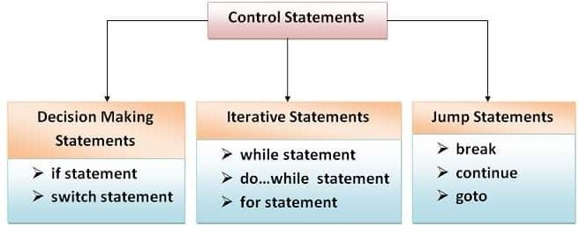
Control Statements

Slide 2
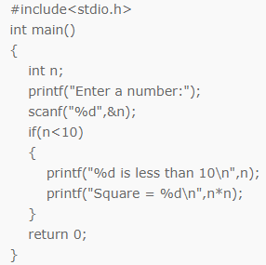
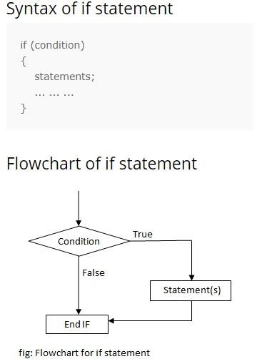
1.Decision Making Statement
If Statement

Slide 3
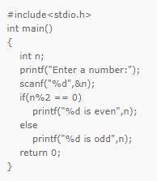
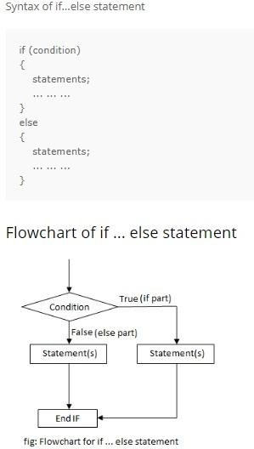
If else Statement

Slide 4
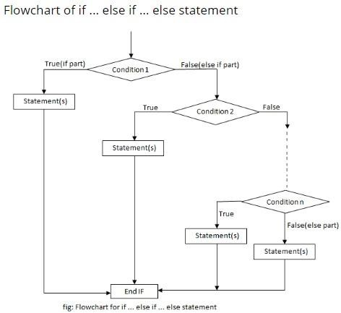
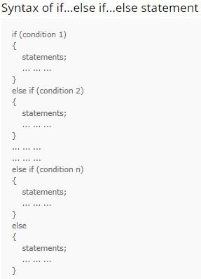
If-else if Statement

Slide 5
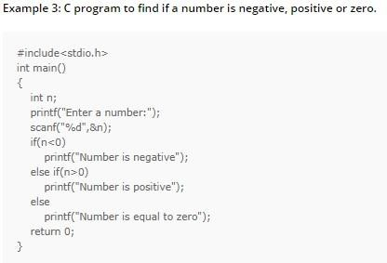
Example- if ... else if ... else statement

Slide 6
2. Switch Statement
A switch statement tests the value of a variable and compares it with multiple cases.
Once the case match is found, a block of statements associated with that particular case is executed.
The default case is an optional one. Whenever the value of test- expression is not matched with any of the cases inside the switch, then the default will be executed. Otherwise, it is not necessary to write default in the switch

Slide 7
Syntax-Switch statement
Switch(expression)
{
case value 1:
// code to be executed
break; // optional
case value 2:
// code to be executed
break; // optional
------------
default :
// code to be executed if all cases are not match
}

Slide 8
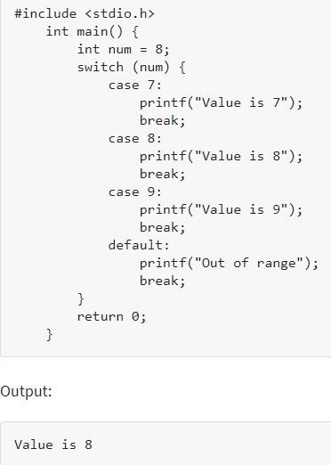

Slide 9
Looping Statements
A certain condition is reached.
There are mainly two types of loop:
1. Entry Controlled loop:
In this type of loop the test condition is tested before entering the loop.
Example- for loop and while loop
2. Exit Controlled loop:
In this type of loop , the test condition is tested or evaluated at the end of loop. Therefore the loop body will execute at least once irrespective of whether the test condition is true or false.
Example- do-while loop

Slide 10
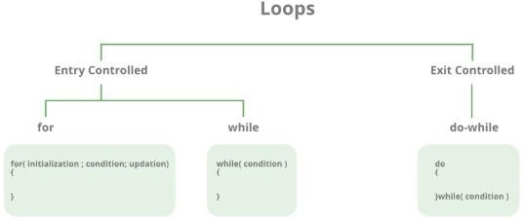

Slide 11
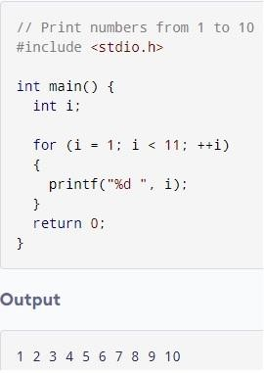

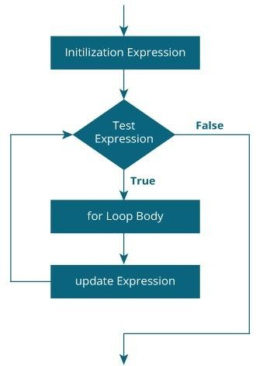
For Loop
Syntax and Example

Slide 12
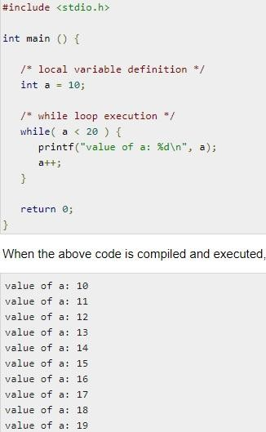

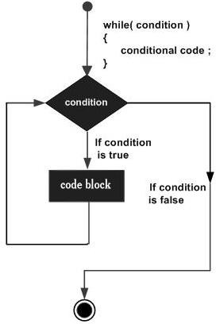
While Loop
Syntax and Example

Slide 13
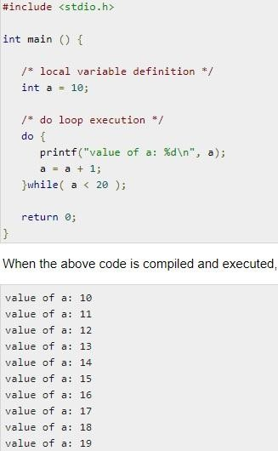

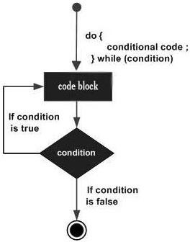
Do…..While Loop
Syntax and Example

Slide 14
3. Jump Statement
Break Statement(Keyword break)
Break statement is used inside loop and switch statements. It cause immediate exit from that loop in which it appears and it is generally written with condition. It is written with the keyword as break.
When break is encountered inside any loop, control automatically passes to the first statement after the loop. This break statement is usually associated with if statement.
Example :
void main()
{
int j=0;
for(;j<6;j++)
if(j==4)
break;
}
Output:
0 1 2 3

Slide 15
Continue statement (key word continue)
Continue statement is used for continuing next iteration of loop after skipping some statement of loop.
When it encountered control automatically passes through the beginning of the loop. It is usually associated with the if statement. It is useful when we want to continue the program without executing any part of the program.
Example:-
void main()
{
int n;
for(n=2; n<=9; n++)
{
if(n==4)
continue;
printf(“%d”, n);
}
}
Printf(“out of loop”);
Output: 2 3 5 6 7 8 9 out of loop

